Slide 2
Real-Time Market Data Forecasting
Final Report for CS 4563
Mingjian Li, Wes Simpson
Professor: Linda N. Sellie
NYU Tandon School of Engineering

Slide 3
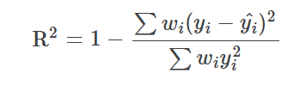
Introduction
Dataset Overview
Time Series Data with 79 features and 9 responders
Chronological structure: date_id, time_d=id
Weight: The weighting used for calculating the scoring function.
4.5 million rows !!!

Slide 4
Introduction
4.5 million rows
Objective: Forecast responder 6
Processed Data
Understanding
Feature Transformation
Linear Regression
Fit Models
Our solution
Model Evaluation
Neural Network
Results
LSTM

Slide 5
Data Analysis
4.5 million rows
Processed Data
Understanding
Preprocessing
Unsupervised Learning

Slide 6
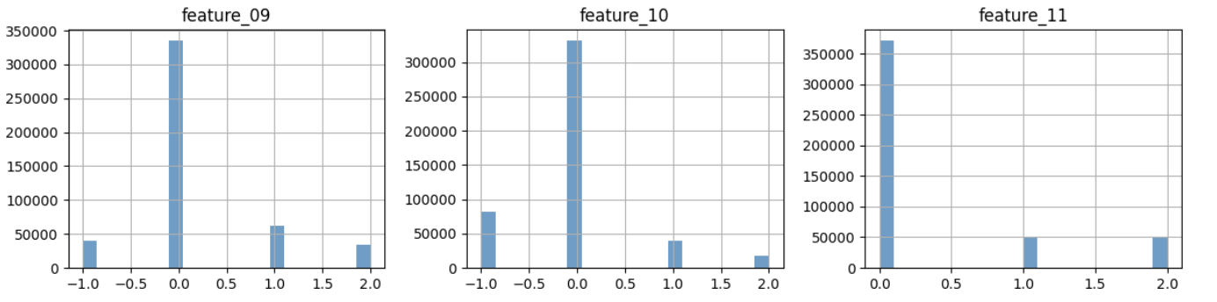
Data Analysis
Preprocessing
Sampling 1%. Group by date_id for good representative
Memory Reduction - Data Type Manipulation
Size reduced by 47.6 %
Categorical Data – Already Encoded

Slide 7
Data Analysis
Preprocessing
Missing Values
Categorical Features: Missing values in categorical features were filled using the most frequent value in each category.
Numerical Float Features: For numerical features, missing values were imputed using the mean of each column to minimize the impact of outliers.

Slide 8
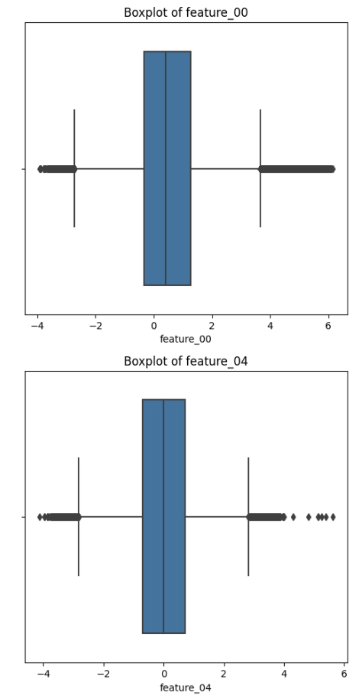
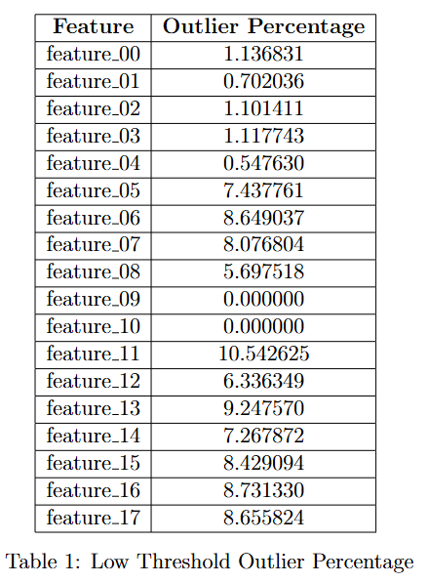
Data Analysis
Preprocessing
Outliers- IQR (Interquartile range)
[Q1 −1.5 × IQR, Q3 + 1.5 × IQR]
1.5 threshold is too low

Slide 9
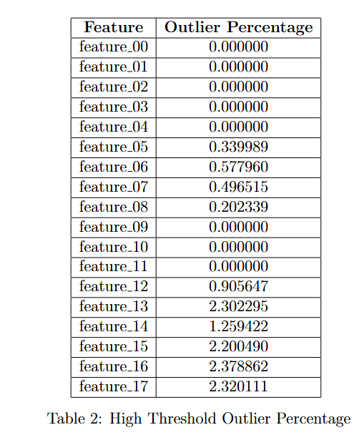
Data Analysis
Preprocessing
Outliers - IQR
Raise to 5
[Q1 −5 × IQR, Q3 + 5 × IQR]
Remove? - reduced our data size from(471486, 79) to (37822, 79)
Replaced them with mean values.
For categorical features (int type column feature), we replaced the outliers with rounded mean for data type consistency

Slide 10
Data Analysis
Preprocessing
Scaling and Normalizing
remove the mean of the data and scale them to unit variance
Min and Max scaling method
For integer columns, we cast the float part

Slide 11
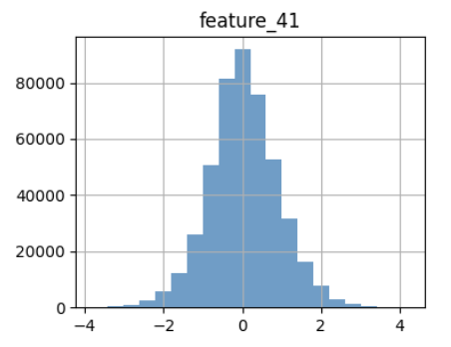
Data Analysis
Visualize Data Distribution
Unsupervised Learning
Well-distributed

Slide 12
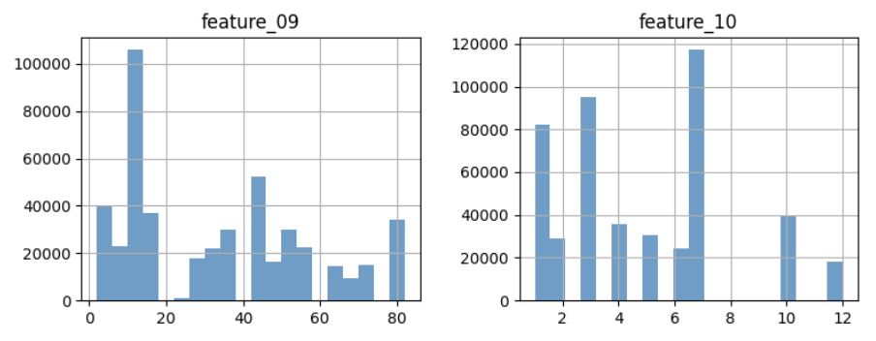
Data Analysis
Visualize Data Distribution
Unsupervised Learning
Multimodal

Slide 13
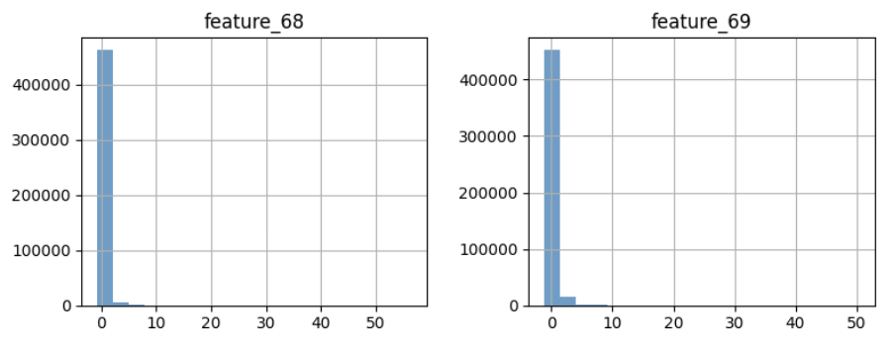
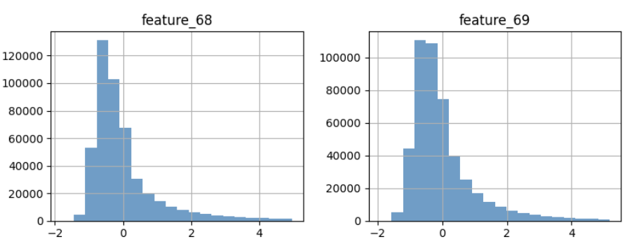
Data Analysis
Visualize Data Distribution
Unsupervised Learning
[05, 06, 07, 08, 12, 13, 14, 15, 16, 17, 21, 29, 30, 31, 37, 38, 47, 48, 49, 58, 59, 60, 62, 63, 64, 67, 68, 69, 70, 71, 72, 73, 74, 75, 76, 77, 78]
Plot Size Limitations ?
Small Scale of Original Data ?
Imbalanced Features ?
Come back to this features after scaling
Extremely Unbalanced

Slide 14
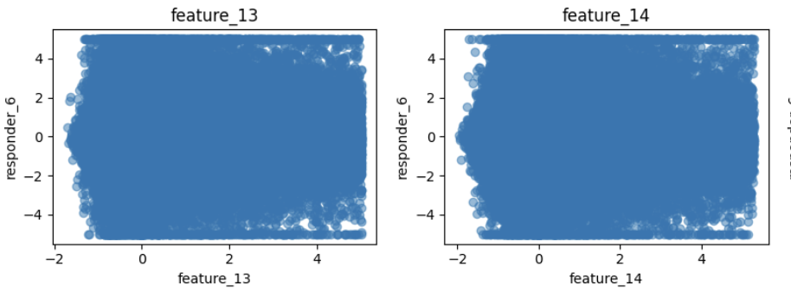
Data Analysis
Pretty Random
Visualize Individual Features with Target
No simple Linear Relationship ?
- feature transformation
No valuable information?
- PCA
If the data exhibit seasonal trends as part of a time-series structure, scatter plots alone may fail to provide accurate insights.
- LSTM

Slide 15
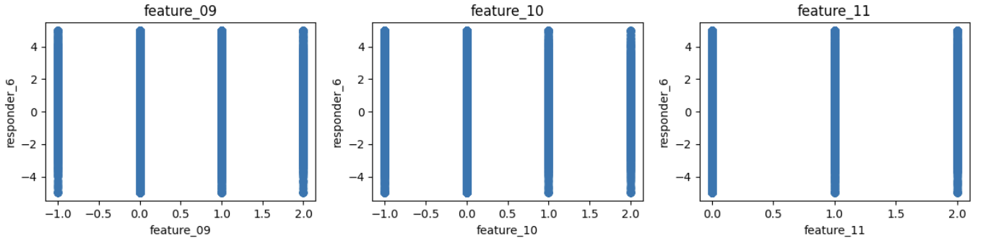
Data Analysis
Visualize Individual Features with Target
Encoded Categorical Feature

Slide 16
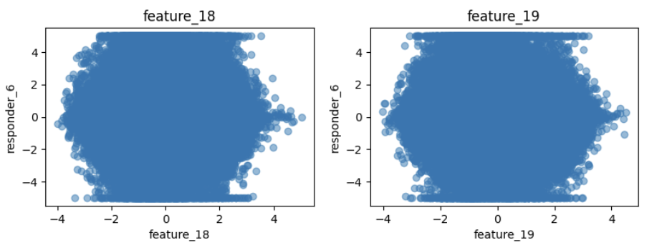
Data Analysis
Visualize Individual Features with Target
Polynomial Relationship?
- Polynomial Transformation
Rounded Shape

Slide 17
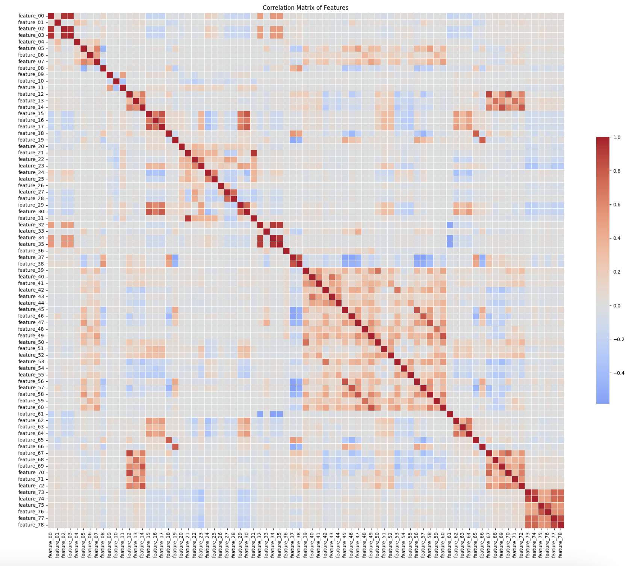
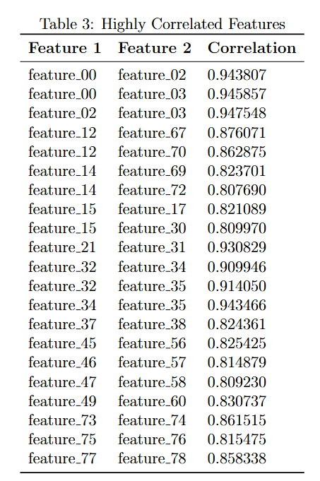
Data Analysis
Visualize Correlation Matrix

Slide 18
Data Analysis
Visualize Correlation Matrix
Feature Removal: Eliminate some of the highly correlated features to reduce multicollinearity and simplify the model.
Regularization: to minimize the impact of less important features
Feature Engineering: Create new features that represent combinations or transformations of the highly correlated features to better capture their relationships.

Slide 19
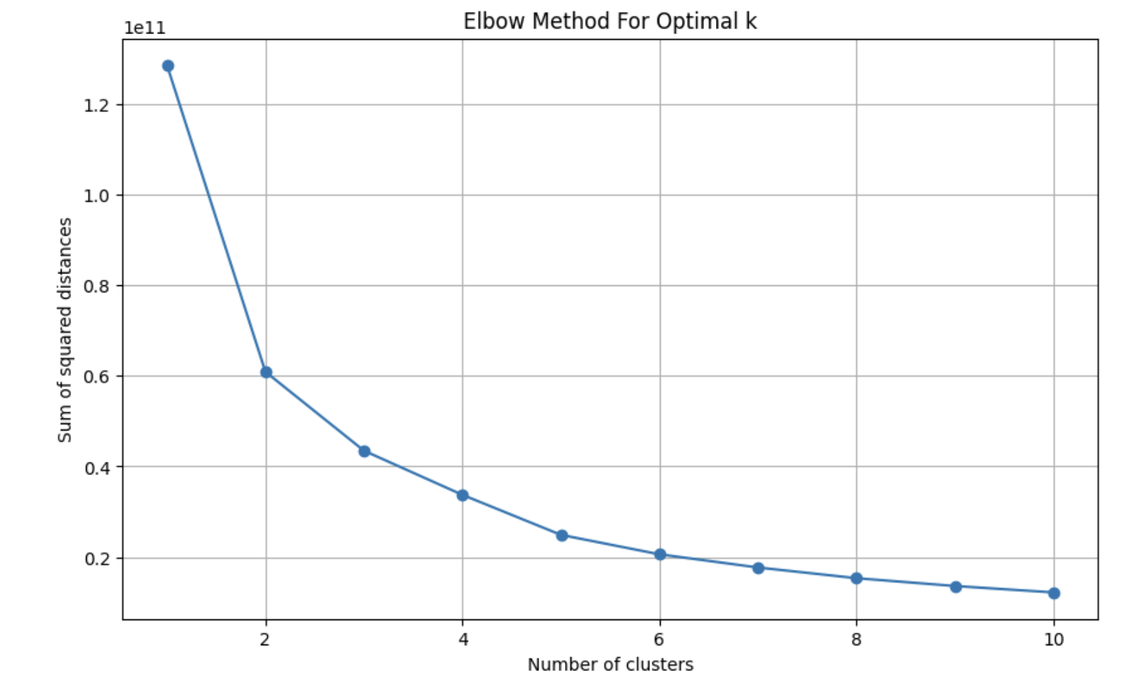
Data Analysis
Clustering - K-means
Get the best number of K by Elbow Method
K =2

Slide 20
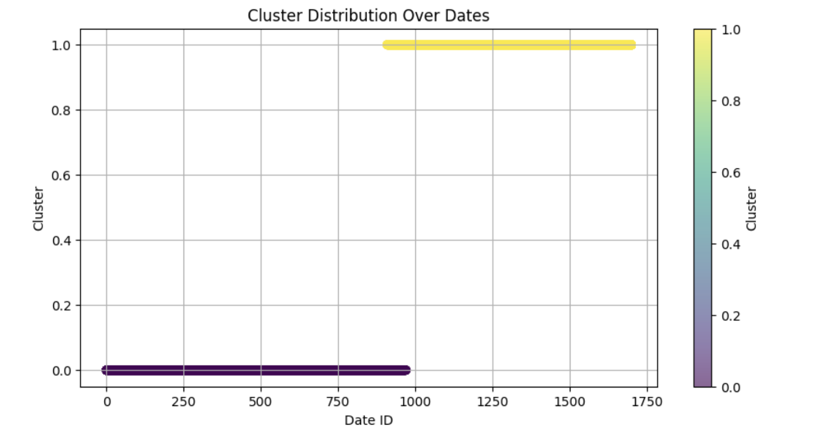
Data Analysis
Clustering - K-means
Cluster distribution Over date_id
1. Temporal Patterns: Features exhibit distinct patterns during two different time periods.
2. Continuous Change Over Time: Since the data are time-series, the observed distribution may reflect a gradual evolution in patterns over time.

Slide 21
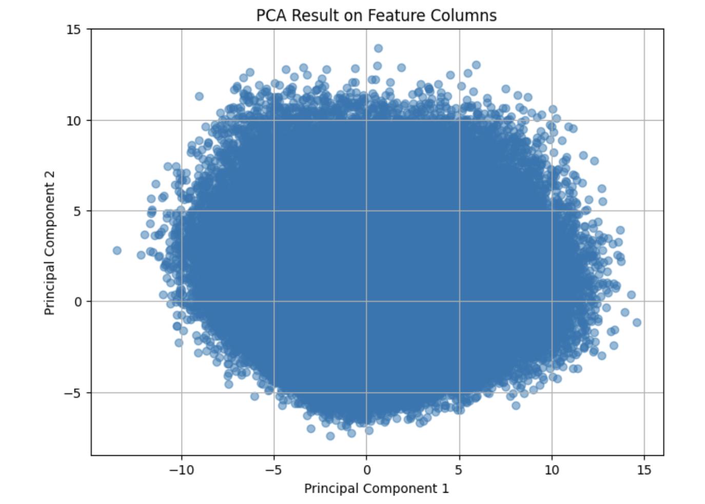
Data Analysis
PCA
2 Components
PC1 explains 11.01%
PC2 explains 8.98% of the variance, respectively.

Slide 22
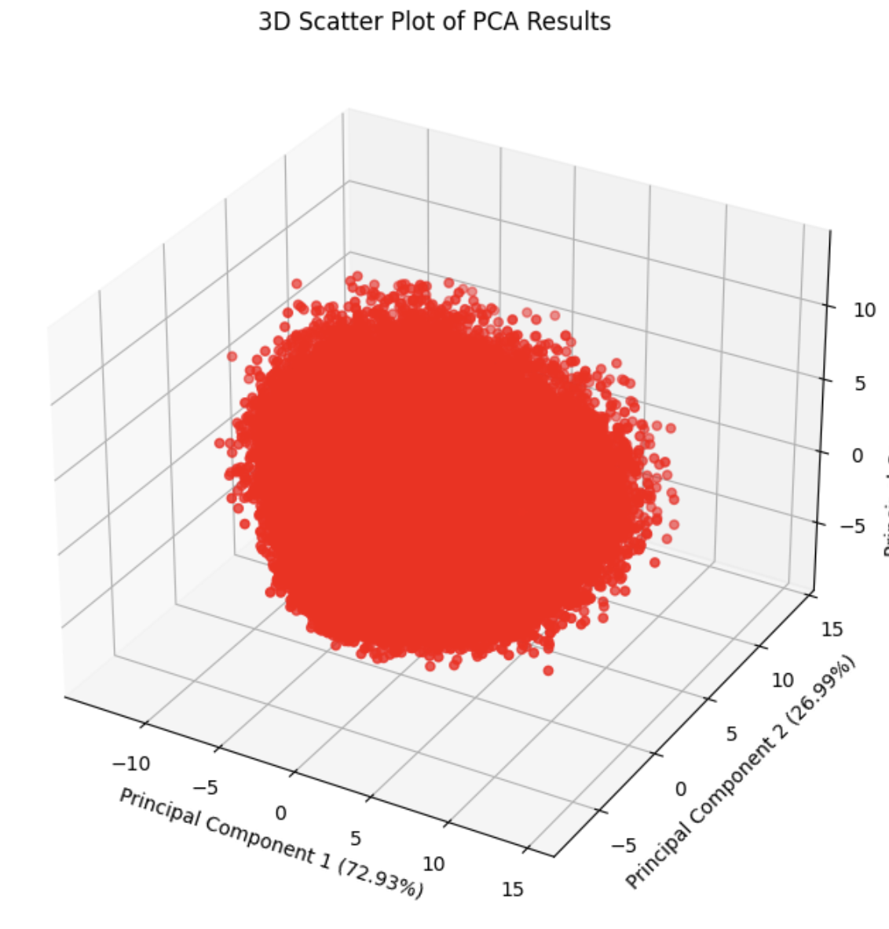
Data Analysis
PCA
3 Components
PC1 explains 11.01%
PC2 explains 8.98%
PC3 explain 7.93% of the variance, respectively.

Slide 23
Data Analysis
Observations:
PCA
Elongated, slightly circular distribution
This pattern suggests a possible linear relationship between PC1 and PC2 for a significant portion of the data, as the points tend to align along a line or curve.
PC1 captures the largest share of variability, with data points showing the greatest spread along this axis.No clear clustering is evident in the PCA scatter plots, indicating that the dataset does not contain strongly distinct or separable groups based on these two or three components.

Slide 24
Linear Regression
Model I – Linear Regression

Slide 25
Linear Regression
Preparation
Data: We have preprocessed out data in Section 2. We only split the processed data into training set(80%) and validation set(20%) here.
Metric: R Square

Slide 26
Linear Regression
With Polynomial Transformation
Motivation: Observing the scatter plot between some features and the target, which exhibits a rounded shape, we assumed that a polynomial transformation with a degree of 2 might capture some valuable information.
Result: a negative R-squared value of -0.00413879 ☹

Slide 27
Linear Regression
With Polynomial Transformation
Result: a negative R-squared value of -0.00413879 ☹
Indicates that our model's performance is slightly worse than simply predicting the mean of the target variable for all observations. The model does not fit the data well. It is not capturing the variance in the target variable effectively.
Due to its excessive computational demands and extremely poor results, we discontinued this method in favor of exploring alternative approaches.

Slide 28
Linear Regression
RBF Kernel + Ridge Regularization
Motivation: high dimensionality and complexity of our data. RBF Kernel is a suitable method for learning complex patterns and relationships
Ridge Regression to avoid overfitting

Slide 29
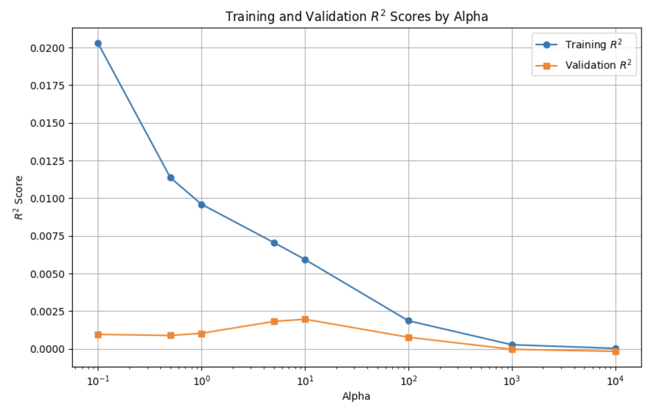
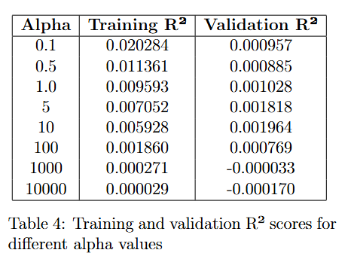
Linear Regression
RBF Kernel + Ridge Regularization

Slide 30
Linear Regression
RBF Kernel + Ridge Regularization
The RBF Kernel displayed better performance than polynomial transformation
Ridge Regression proved effective.
We observed a significant gap between Training R-squared and Validation R-squared at lower alpha values, indicating overfitting.
The optimal performance was noted at alpha = 10 although the model still exhibited signs of underfitting.

Slide 31
Linear Regression
PCA+ Ridge Regularization
Motivation: One of our assumptions during data analysis is that in out 79 features, some of them do not carry valuable information. Thus, we applied PCA to reduce the feature space, hoping to achieve better results
Ridge Regression to avoid overfitting

Slide 32
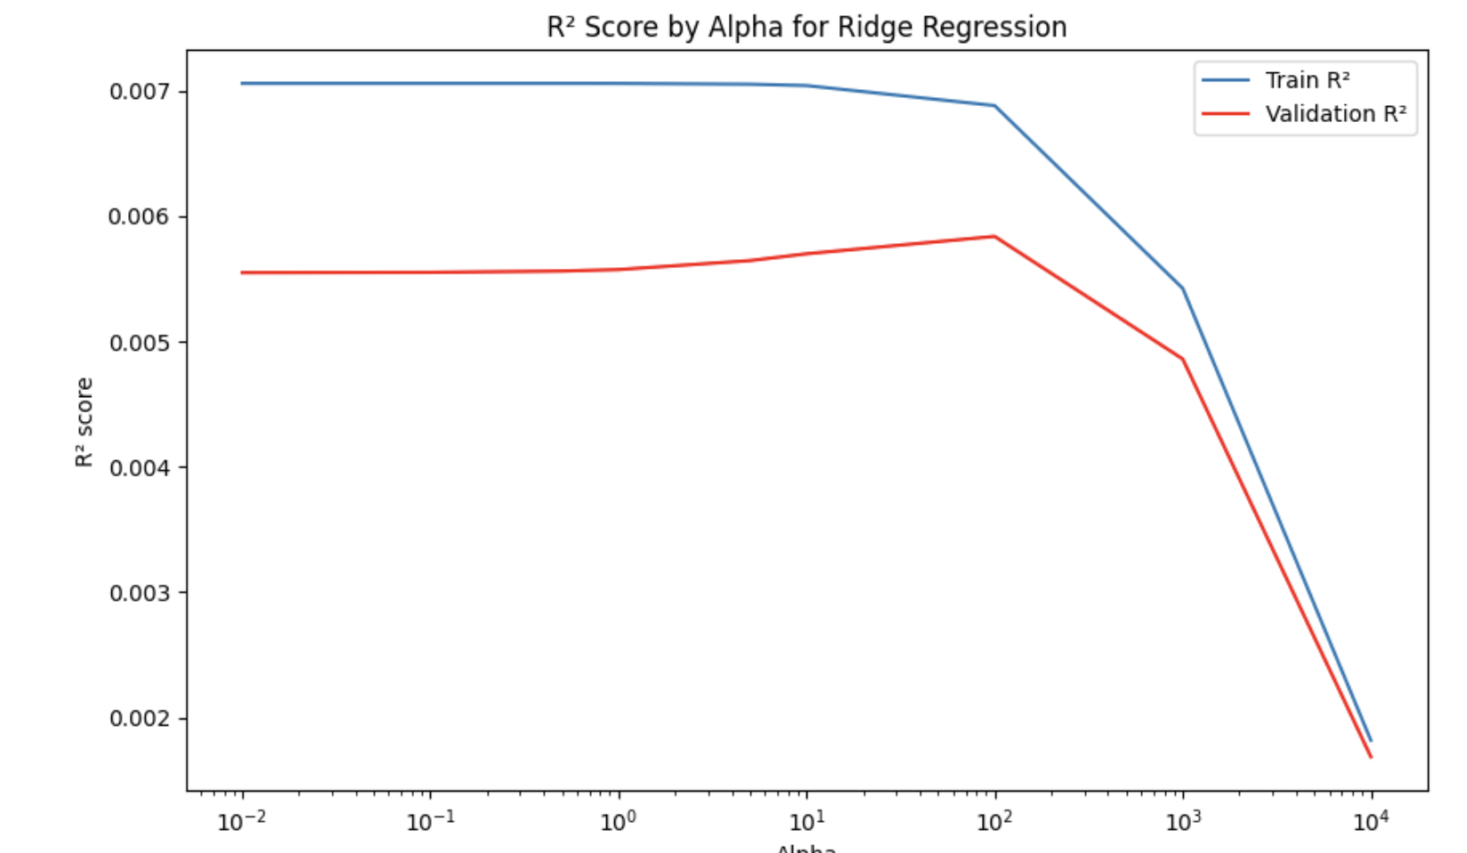
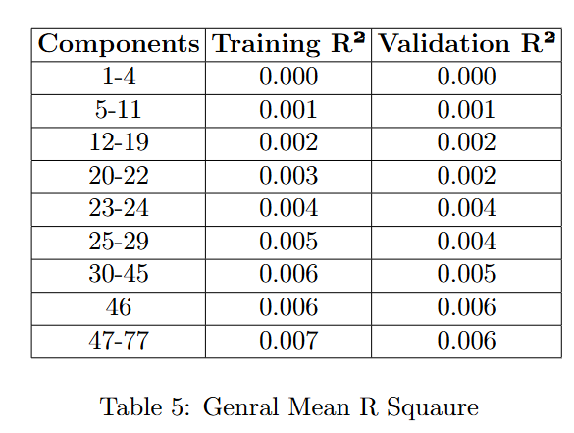
Linear Regression
We tracked the mean R-squared across different numbers of components, with the best performance observed at 46 components.
PCA+ Ridge Regularization

Slide 33
Linear Regression
PCA+ Ridge Regularization
The PCA model outperformed the RBF Kernel with regularization, though it still tended to underfit.

Slide 34
Linear Regression
Model Evaluation
PCA wins !!!

Slide 35
Neural Network
Preparation
Data: We have preprocessed out data in Section 2. We only split the processed data into training set(80%) and validation set(20%) here.
Metric: R Square

Slide 36
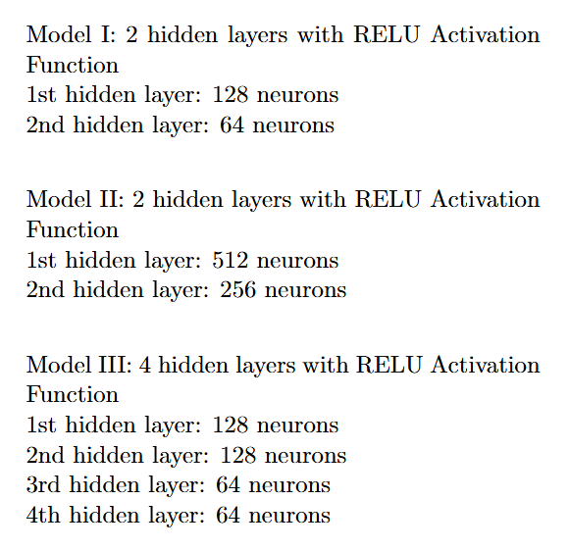
Neural Network
Architecture

Slide 37
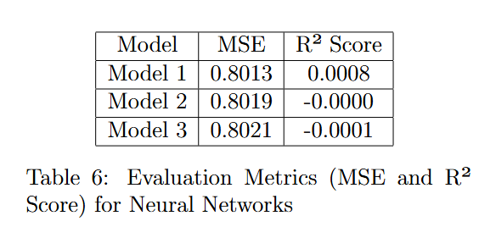
Neural Network
Results

Slide 38
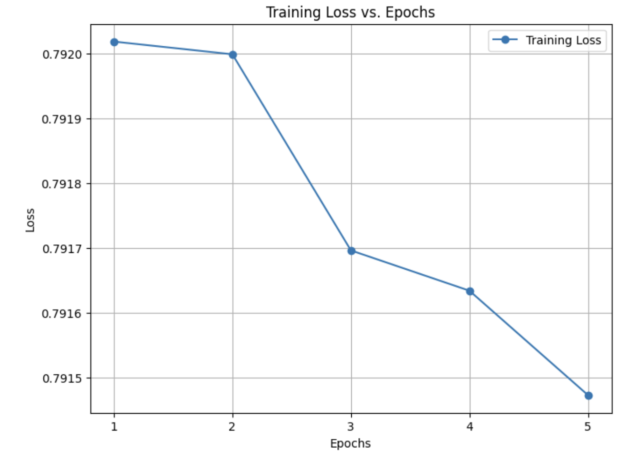
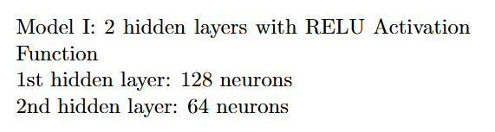
Neural Network
Results

Slide 39
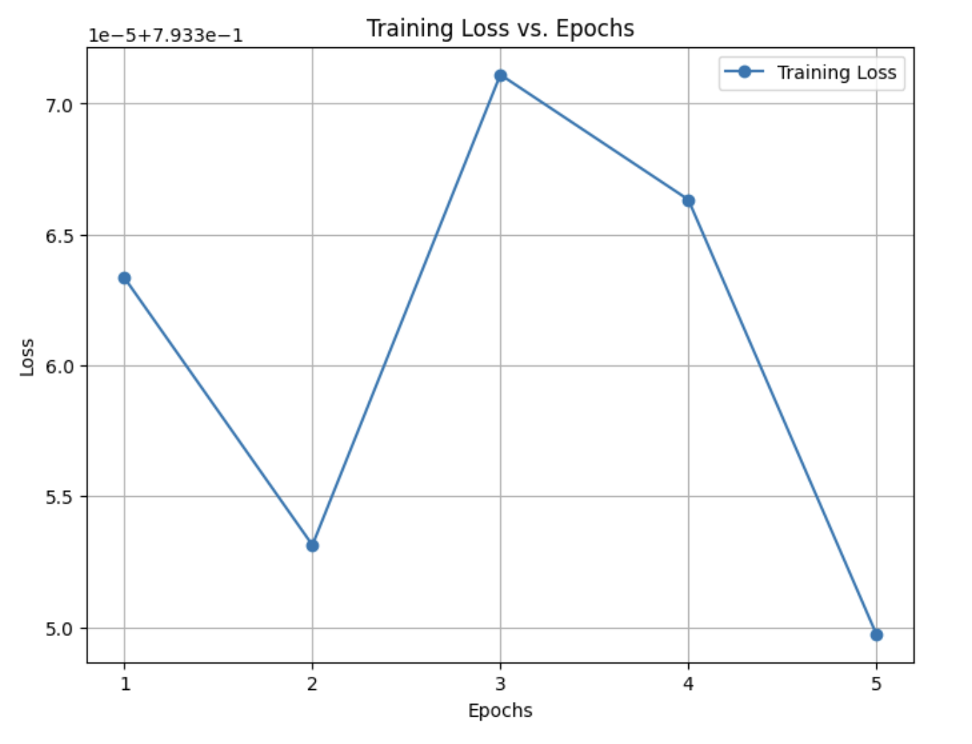
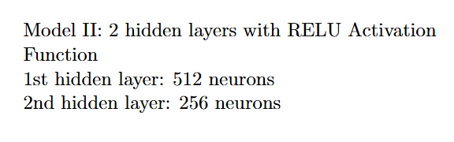
Neural Network
Results

Slide 40
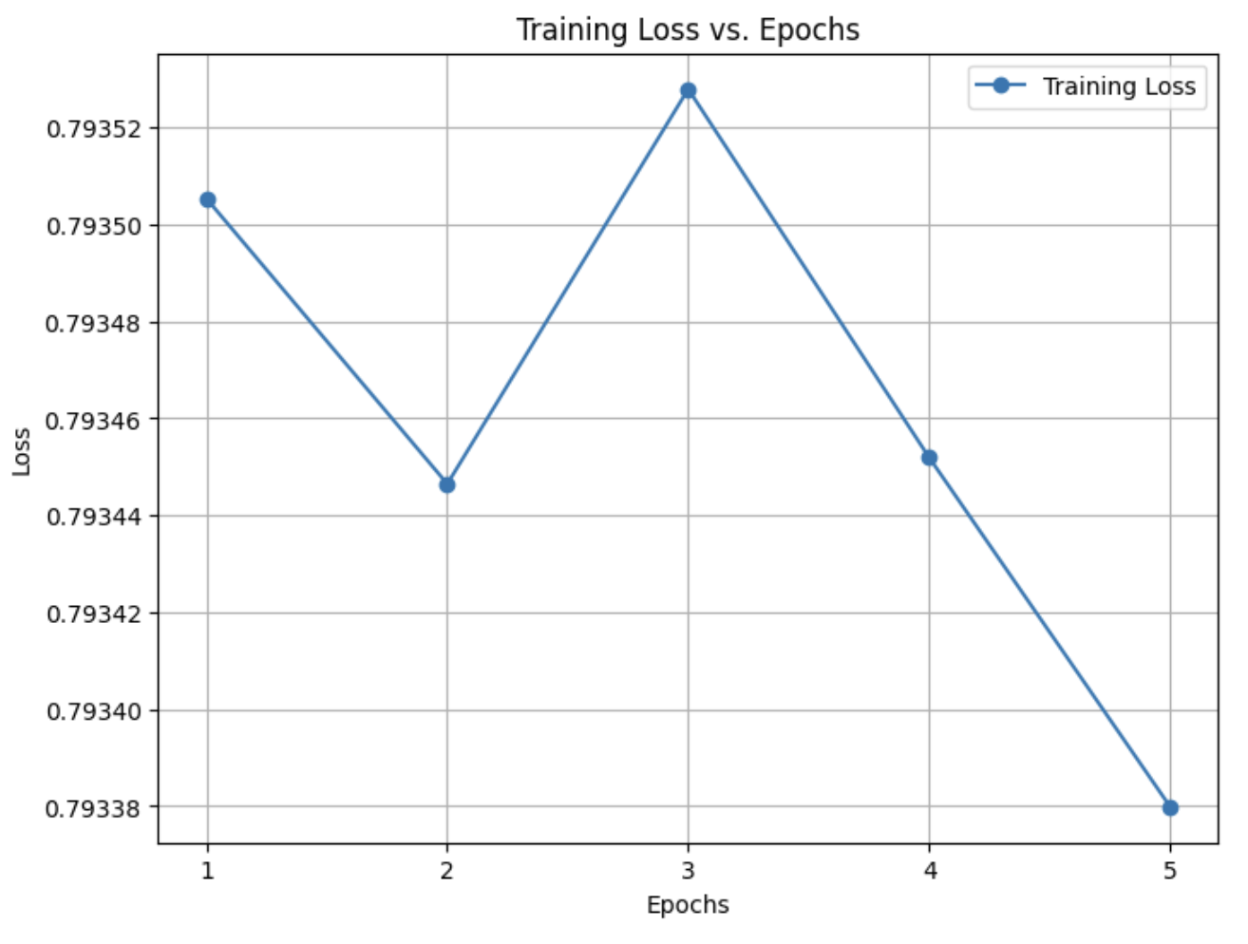
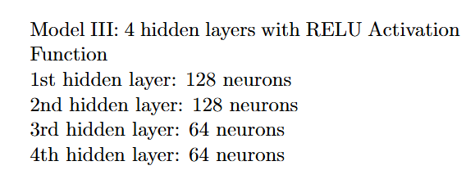
Neural Network
Results

Slide 41
Neural Network
Model Evaluation
Model I outperformed the rest.
Its MSE converges faster and steadier with the increase of epoch.
It has a highest validation R square.

Slide 42
LSTM
Overview
Motivation: LSTM (Long Short-Term Memory) networks are particularly suited for forecasting market data and can effectively manage time-series data, capturing long-term dependencies that other models might overlook.

Slide 43
LSTM
Preparation
Data: We have preprocessed out data in Section 2. We only split the processed data into training set(80%) and validation set(20%) here.
Epoch: We chose Epoch number to be 20 due to limited computational power but still yield decent result.
Metric: We used the MSE as the loss function to perform optimization. We also keep track of sample weighted zero-mean R-squared score to select model. It has a much smaller value compared to R square.

Slide 44
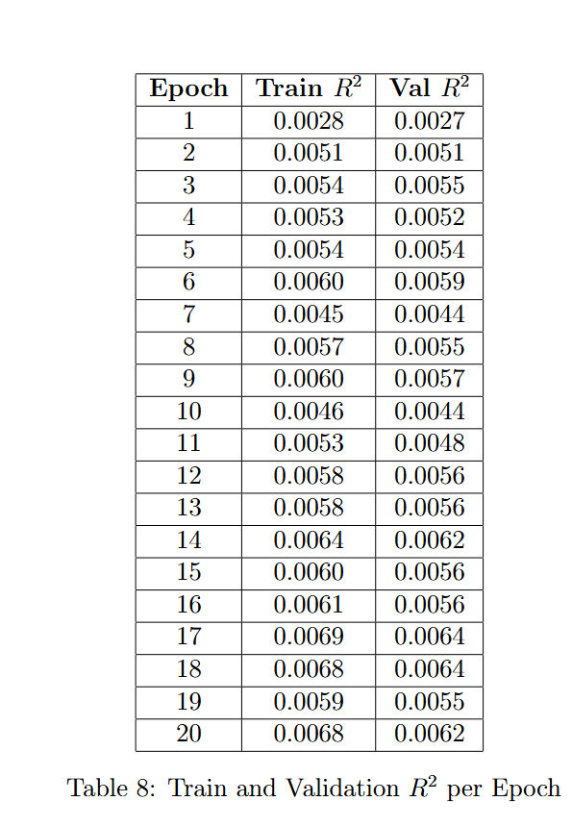
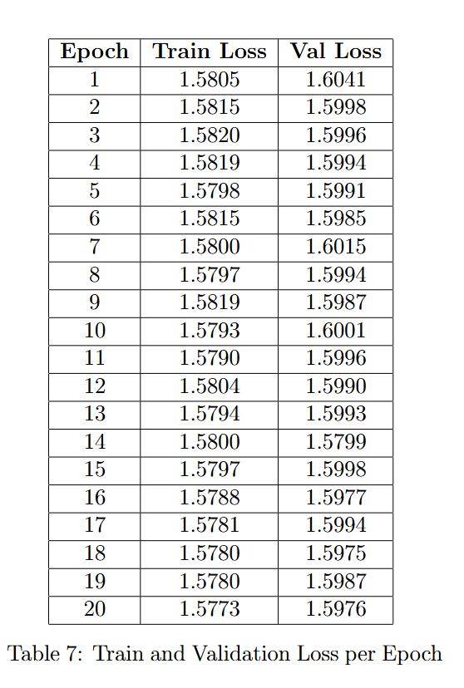
LSTM
Architecture I
2 hidden layers and 64 hidden size

Slide 45
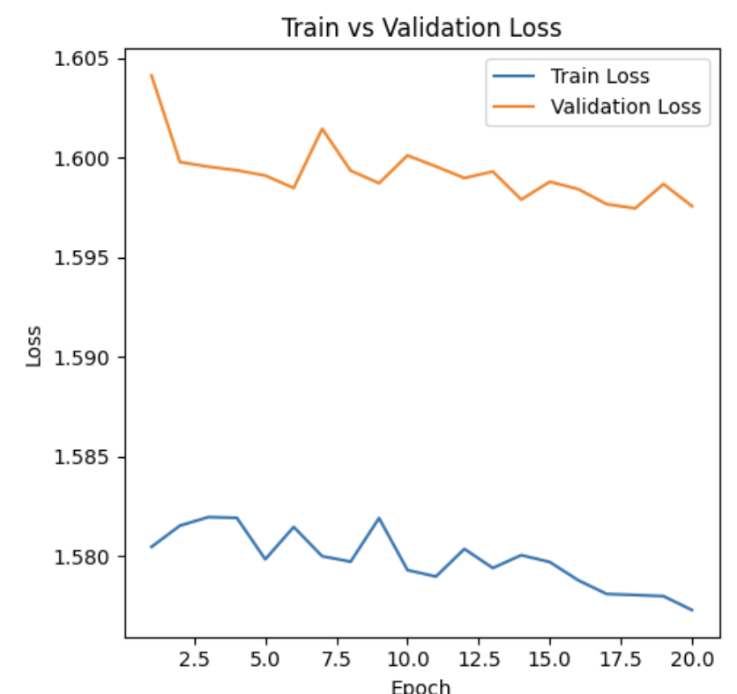
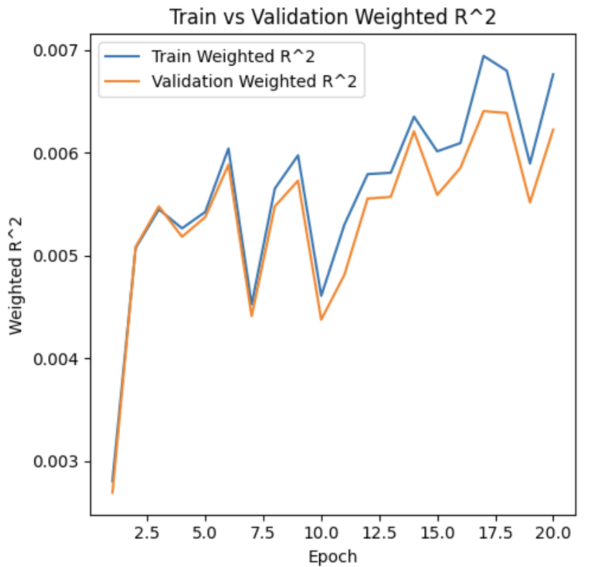
LSTM
Architecture I

Slide 46
LSTM
Architecture I
From the perspective of weighted R square, this model perform well and we might choose model at epoch 17 or increase the number of epochs and try different regularization parameters.

Slide 47
LSTM
Architecture I
However, the MSE loss function have present some interesting behavior. The gap between training loss and validation loss is quite stable thus we cannot determine whether it overfits. We might try different value of regularization parameters in the future.

Slide 48
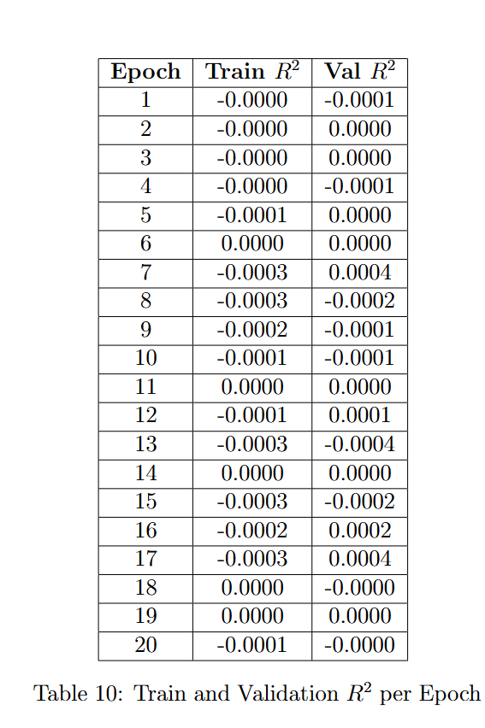
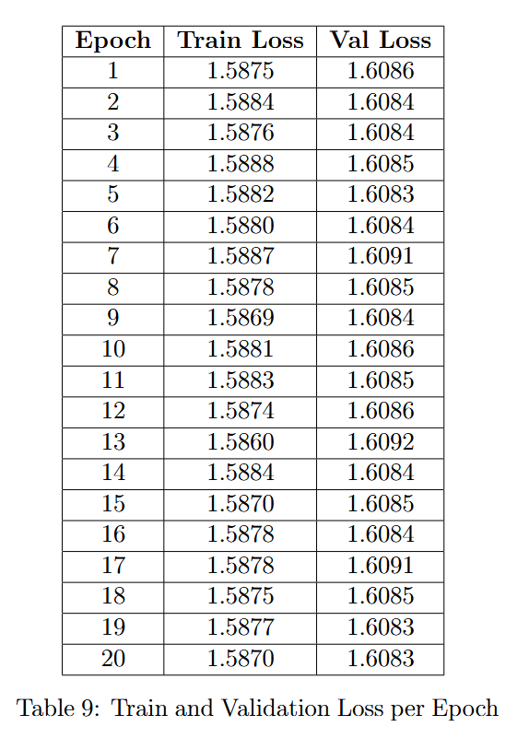
LSTM
Architecture II
3 hidden layers and 128 hidden size

Slide 49
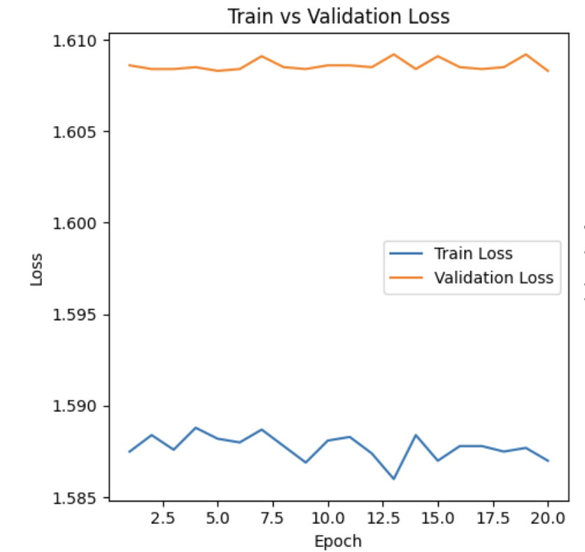
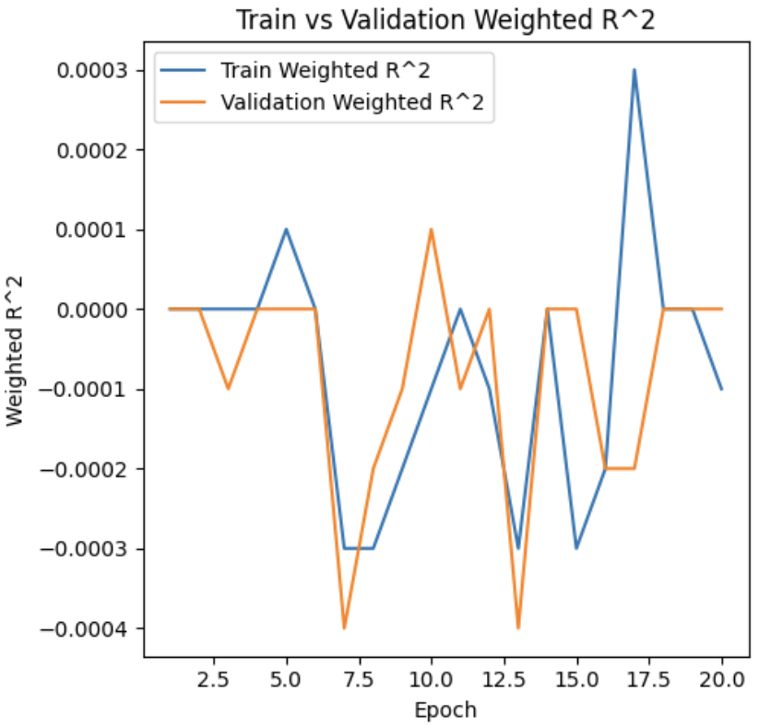
LSTM
We can tell that we are overfitting in this model and it performs poorly. Thus, we are going to try simpler architecture.
Architecture II

Slide 50
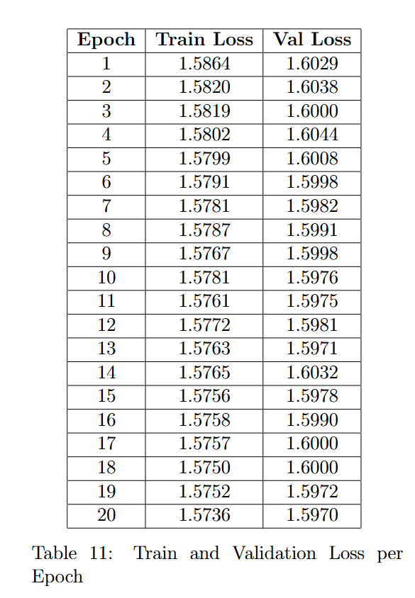
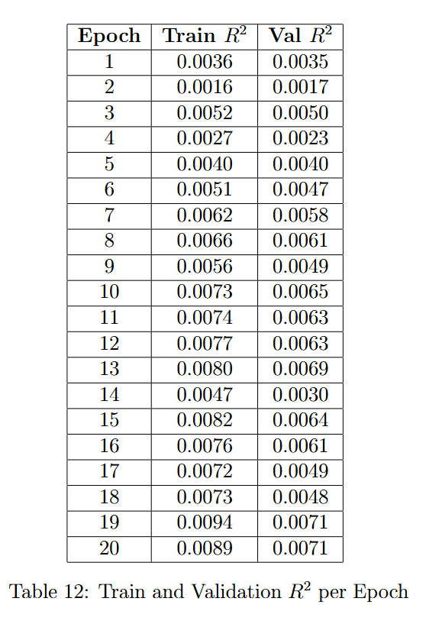
LSTM
Architecture III
1 hidden layers and 32 hidden size

Slide 51
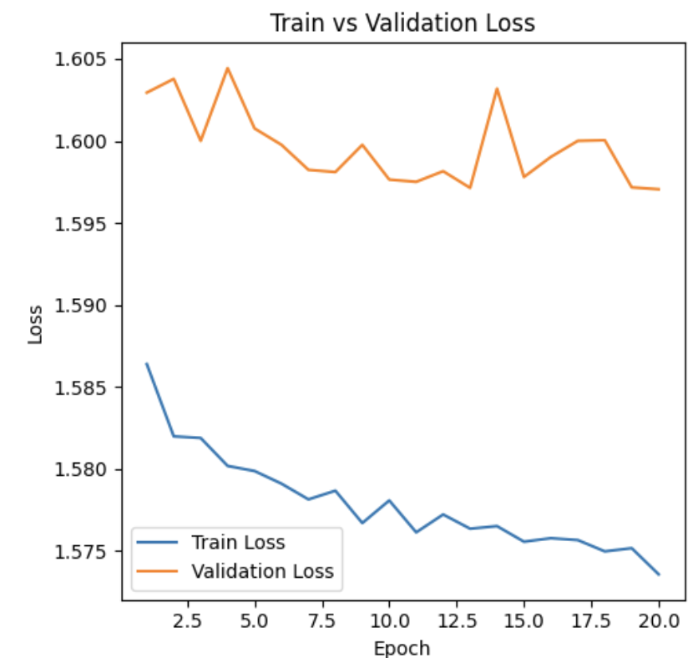
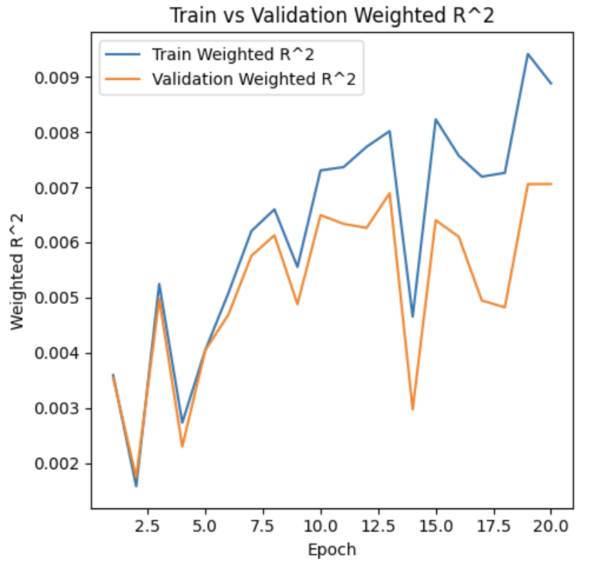
LSTM
We can observe that this simplest LSTM perform really well relatively. However the weighted R square is not quit stable. We need to increase the number of epochs and evaluate how it works further.
Architecture III

Slide 52
LSTM
Model Evaluation
A simpler, well-tuned model (as seen in Architecture III) achieves a robust balance between accuracy and computational efficiency.

Slide 53
Observations
About Symbol_id
referred to a comment by Tucker Arrants on Kaggle who analyze the metadata with domain knowledge. We decide to not fit out models on symbol_id.

Slide 54
Observations
About Symbol_id
These data are highly likely to be generated by high-speed algorithms and the trades Jane-Street executes.Symbol_id likely represents different financial instruments, which can exhibit unique trading characteristics and behaviors.
These differences can skew model performance when generalized across multiple symbols. Additionally, the dynamic nature of financial markets and the evolution of trading algorithms means that the trading patterns and characteristics associated with a specific symbol_id can change over time. Thus, a model trained on historical symbol_id data might not be effective or accurate when predicting future market behaviors, as it fails to generalize well across different periods and conditions. This can lead to overfitting

Slide 55
Key Findings
The sampling strategy employed ensured the representativeness of the data, capturing the chronological structure crucial for time-series analysis.
Memory reduction techniques successfully decreased the data size by 47.6%, enhancing computational efficiency.
Outlier handling was optimized by adjusting the threshold, which preserved a significant amount of data while maintaining data integrity.

Slide 56
Key Findings
Data preprocessing included effective handling of missing values and outliers, ensuring robustness and reliability in the subsequent analysis.
Scaling and normalization significantly improved the distribution of features, which was crucial for the accuracy of predictive models.
The unsupervised learning phase, including clustering and PCA, provided insights into the underlying structure of the data, revealing patterns not immediately apparent.

Slide 57
Key Findings
The linear regression models, especially with PCA and regularization, showed potential, although they tended to under fit, suggesting complexity in the data beyond linear relationships.
Neural networks did not significantly outperform simpler models, indicating that more complex models might not always yield better forecasts in this dataset.
LSTM models demonstrated the ability to capture long-term dependencies in time-series data, although further tuning and regularization is required to optimize performance.

Slide 58
Improvement in the Future
New methods to handle missing values. Maybe use regression or clustering method to fill missing values.
Use a larger amount of the data
Try more regularization methods and different hyper-parameters.
More time-series related visualization and analysis

Slide 59
Conclusions
The exploration of various machine learning models in forecasting real-time market data provided valuable insights into the complexity and challenges of predictive modeling in financial markets. Our findings revealed that while linear models with regularization and PCA showed promise, they often under-fitted, highlighting the complexity of the data. Neural networks did not yield significantly better results either, suggesting that complexity in model architecture did not necessarily correlate with forecasting accuracy. On the other hand, LSTM networks demonstrated potential in capturing long-term dependencies, though they certainly require further tuning. Future research should focus on enhancing model performance through more sophisticated feature engineering, and perhaps exploring ensemble methods. These efforts will improve the reliability and accuracy of forecasts, which will ideally improve model performance on the highly complex dataset.

Slide 60
Thank You

Slide 61


